Slide 1
ELT ABAP Training
Day 1 – ERP & SAP Overview

Slide 2
Objectives
At the end of this session, the participants will be able to:
Understand evolution of ERP solutions
Understand the importance of ERP, its benefits
Know key players in the ERP market
Understand how SAP product evolved and its architecture
Understand various functional modules / areas within SAP
Get an overview of ABAP programming language
Get to know navigation within SAP

Slide 3
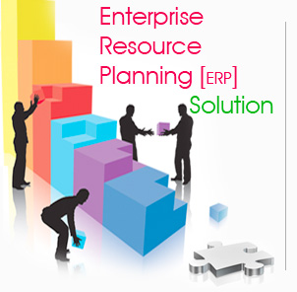
ERP Overview
Evolution of ERP
1960’s – Inventory Management & Control
1970’s – Materials Requirements Planning (MRP)
1980’s – Manufacturing Resources Planning (MRP II)
1990’s – Enterprise Resources Planning (ERP)
2000 Onwards – Web Enabled ERP, Extended ERP
Notes:
From business perspective, ERP has expanded from coordination of manufacturing processes to the integration of enterprise-wide backend processes. From technological aspect, ERP has evolved from legacy implementation to more flexible tiered client-server architecture.

Slide 4
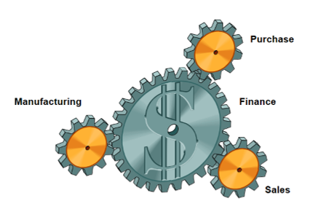
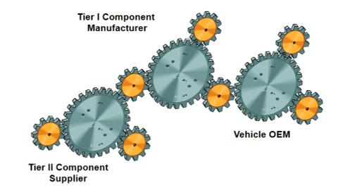
Enterprise Resource Planning
… synchronization of various functions in an enterprise
An integrated suite of business applications, that..
Closely links, monitors, and controls primary enterprise resources like manpower, machine, material, methods, market and money
Enables corporate firms to readily change their processes to adapt to the ever changing business scenario
Provides expertise in industry specific business processes
… and extended to complete the value chain
… and delivering administrative and decisions support system

Slide 5
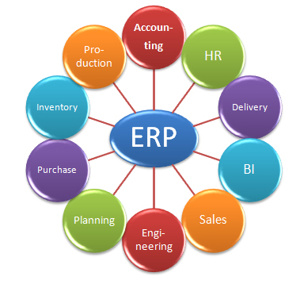
Enterprise Resource Planning
Enterprise resource planning (ERP) is an industry term for the broad set of activities that helps an organization manage its business
ERP is not just a software…but a complete business solution integrated across the entire value chain which creates an information infrastructure for efficient planning and effective execution.
An important goal of ERP is to facilitate the flow of information so business decisions can be data-driven & in timely manner. ERP software suites are built to collect, process and organize data from various levels of an organization to provide management with insight into key performance indicators (KPIs) in real time.

Slide 6
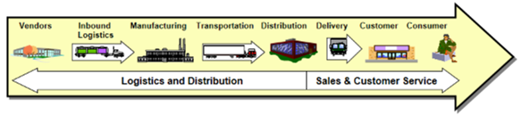
Key Benefits that Clients Expect from an ERP Project
Efficient process & Product management
Integrated supply chain management
Leverage purchasing and vendor management
Customer service improvement
Inventory reductions
Reduced Total Cost of Ownership on an ongoing basis
Improved business management

Slide 7
Business Trends Favoring Growth of ERP
Globalization
Localization aspects
Variety of languages
Business process variations
Different cultures
Business Process Reengineering
Cut development costs
Improve customer service
Reduced time to market
Integration
With BPR, increased need to have integrated solutions
Diverse technology platforms
Technology Improvements & Pricing
Evolving technology
Different licensing models
Notes:
Platform based licensing and pricing – Licensing and Pricing of mainframe based packaged applications were tied to size of mainframe system on which application runs

Slide 8
Results Expected out of ERP Culture
Reduced working capital requirements
Improved customer service
Improved productivity
Reduced purchase costs
Reduced overtime
Availability of data to help make business decisions
Having accountability throughout the organization
Improved quality of life
Notes:
Platform based licensing and pricing – Licensing and Pricing of mainframe based packaged applications were tied to size of mainframe system on which application runs

Slide 9
Well-known ERP Vendors
SAP AG
Oracle (PeopleSoft and JD Edwards taken over by Oracle)
Baan (As of May 2006, its under Infor Global Solutions of Atlanta)
MFG/PRO
Navision (Microsoft Dynamics NAV)
Notes:
Platform based licensing and pricing – Licensing and Pricing of mainframe based packaged applications were tied to size of mainframe system on which application runs

Slide 10
SAP – Few Facts
SAP – Systems , Applications and Products in data processing
SAP R/3 is an ERP software package.
SAP AG founded in 1972 in Germany.
Market leader in Industrial Enterprise Applications.
Customers in 190 countries
2015 annual revenue of EUR 20.8 Billion
13,300 SAP partner companies globally
Strong client base of fortune 500 and fortune 100 companies
Notes:
Platform based licensing and pricing – Licensing and Pricing of mainframe based packaged applications were tied to size of mainframe system on which application runs

Slide 11
History of SAP
Year | Event(s)
1972 | Five former IBM employees founded SAP AG
1973 | SAP R/1
1979 | SAP R/2
1991 | SAP R/2 supports RDBMS
1992 | SAP R/3 (introduced client server architecture)
1993 | Not only Linux, SAP R/3 supports Windows NT
1995 | SAP R/3, a big success
1996 | SAP Internet Transaction Server (ITS)
1997 | SAP BW, SAP CRM, ASAP methodology
1998 | SAP R/3 4.0B, SAP EBP
1999 | SAP APO, SAP R/3 4.5B, SAP R/3 4.6B
2001 | SAP R/3 4.6C, SAP J2EE, SAP EP 5.0
Year | Event(s)
2002 | SAP Business One, SAP MDM, SAP XI
2003 | SAP R/3 4.7
2004 | Web Dynpro for Java, SAP NetWeaver 2004
2005 | SAP ECC 5.0, Sap WebAS 6.40, SDN Community, SAP NetWeaver 2004s
2006 | SAP GRC, Web Dynpro for ABAP, SAP ECC6.0, SAP WebAS 7.0
2007 | SAP BRF, SAP Business Objects
2010 | SAP buys Sybase, SAP HANA
2011 | SAP buys Success Factors, SAP TM
2012 | SAP buys Ariba, SAP NetWeaver for cloud,
2013 | Screen Personas, SAP HANA Enterprise cloud
2014 | SAP buys Concur
Notes:
R/2
Terminal server architecture
“Greenscreen”UI
R/3
Introduced client server architecture
Uses BASIS for technology stack
Desktop client UI
R/3 Enterprise
Replaced BASIS with WebAS (Web Application Server)
Web Based UI
mySAP
Web based UI
Changed “WebAS” to just “AS”
BASIS:
R/3
BASIS is the complete technology stack and application stack
Runs ABAP programs (all application logic is contained in the BASIS server)
BASIS acts as the application server using proprietary protocols to communicate to the desktop client
All changes to SAP application made in BASIS
For R/3 Enterprise
BASIS was split into BASIS and WebAS (WebAS uses standard internet protocols to communicate with web browsers)
BASIS version numbers aligned with WebAS versions
BASIS conceptually used only for administration (migrations, performance monitoring)
For mySAP
BASIS conceptually equal to WebAS
WebAS
Application server that replaced BASIS
Uses standard internet protocols so it can communicate with web browsers
Hosts ABAP engine (runs ABAP applications)
Version 6.20 had the first J2EE engine so you could write Java applications as well as ABAP
ECC (ERP Core Components)
Separates application logic from technology stack
All the modules you would buy(e.g. Payroll) are thought of now as in ECC (before they were thought of as in BASIS)
NetWeaver
This is just a bundling of standard technology stack components that are released together
WebAS (renamed as AS going forward)
Enterprise Portal
Business Intelligence
Exchange Integration

Slide 12
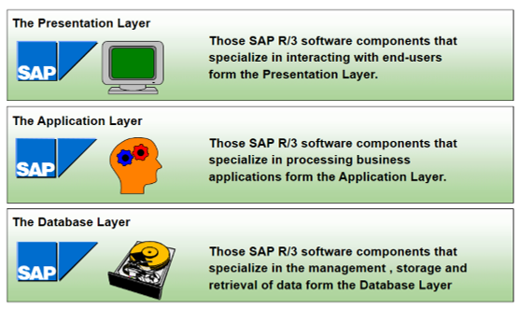
SAP R/3 – 3 Tier Architecture

Slide 13
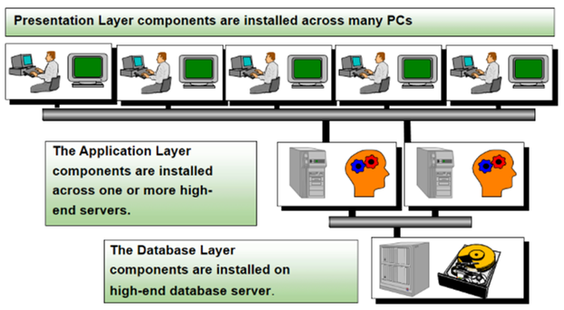
SAP R/3 – 3 Tier Architecture

Slide 14
SAP R/3 Components
Master Data
Transaction Data
Application
ABAP Programs
Organization Structure
Key Data Elements
Functionality Configurations
Configuration

Slide 15
Customization of a Software & ABAP Programming
Customization of a Software:
The adoption of application software to client-specific needs is accomplished in two ways:
Coding – Developing client-specific code that replaces or complements application components
Configuration – Rendering the application appropriate to a customer by maintaining the data on which the application operates. Configuration can also be considered as metadata. Configuration settings are stored as data in tables and not as code and hence it survives software upgrades etc.
ABAP Programming:
SAP R/3 applications are written in ABAP programming language and run within application layer of R/3 system.
ABAP programs communicate with the database management system of the central relational database (RDBMS), and with the graphical user interface (SAPGUI) at presentation level.

Slide 16
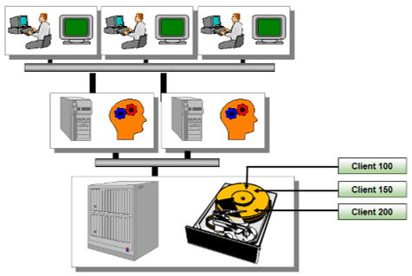
SAP Client Overview
A client is a logical portion of an SAP R/3 physical database. From a business standpoint, a client can be interpreted as a logical group of companies.
All customizing (configuration) and development (ABAP) work in SAP R/3 is performed in a client. However, the data from both customizing and development work may be stored within an individual client (client dependent data) or among all clients (client independent data) in the system.
The data in each client may be separate from that of the other clients. There are basically two types of data in an SAP R/3 System. Client-dependent and client-independent data.
Client-dependent data is defined as data specific to an individual client.
Client-independent data can be defined as data contained across all clients in the system.

Slide 17
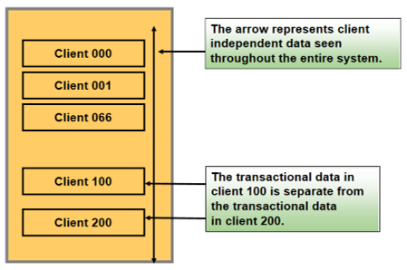
Client Dependent vs. Client Independent
Some examples of client-dependent data include number ranges, ABAP variants, and user masters as well as the data that is created or updated through SAP R/3 transactions transaction data).
Examples of client-independent data include data dictionary objects (tables, views), ABAP source code, screens, and menus.
All data resides in tables. To determine if a particular table is client-dependent or client-independent, the table structure needs to be reviewed. The table structure can be viewed by the data dictionary (Transaction SE11). If MANDT is the first key field of the table, then the table is client-dependent; otherwise, the table is client-independent.
For example, the TSTC table is client-independent; however, the USR01 table is client-dependent.
As shown in the diagram, every SAP R/3 system contains the three clients 000, 001, and 066. They come by default with installation of SAP software.

Slide 18
Developer Access Key
All users who will be editing development objects on the R/3 system must be registered with SAP and assigned a development key.
If a user has not been assigned a development key, system would not allow him/her to perform development activities.
A list of all registered developers can be found in table DEVACCESS. This table displays the registered user ID and associated developer key.

Slide 19
Package
A Package is a group of logically related development objects. A Package contains all the development objects which must be developed, maintained, and sometimes transported together. The objects that make up a transaction usually belong to one Package. Before 4.7 Package was called Development Class.
When creating a new object in the R/3 system, the developer will be prompted to supply a Package. By selecting a valid Package and then a CTS, changes to the object will be recorded in the Transport Organizer.
If the “Local Object” button is selected, the object is classified as a local private object, and changes are not recorded by the Workbench Organizer. Local private objects may not be transported.

Slide 20
Search Help
A Search Help is a search tool to help you find data in the SAP R/3 system.
Sometimes it may be easier to use a Search Help for search purposes. Place your cursor in the desired field and enter the desired search parameter.
You can also activate the Search Helps by placing the cursor in the field and hitting the F4 key.

Slide 21
Demo in System
SAP Navigation
Developer Access Key
Package
Search Help

Slide 22
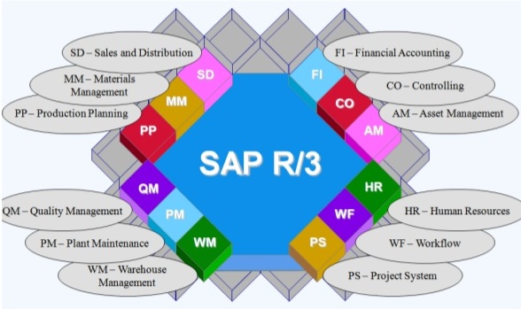
Key SAP Modules

Slide 23
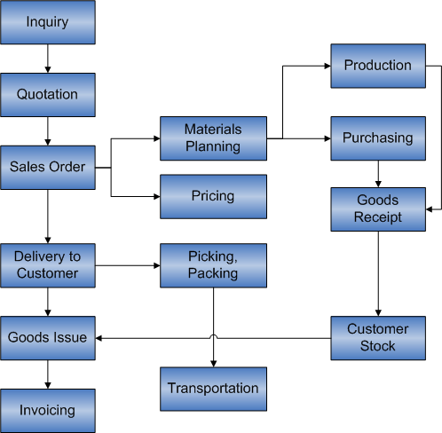
Sales & Distribution Overview

Slide 24
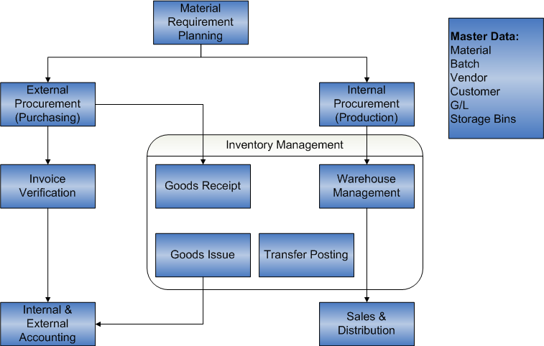
Materials Management Overview

Slide 25
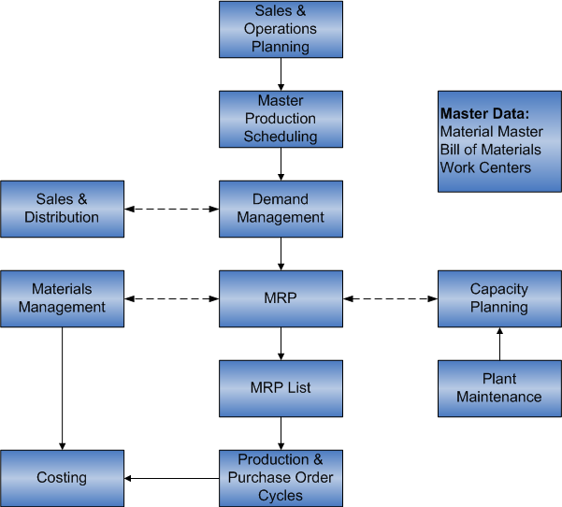
Production Planning Cycle

Slide 26
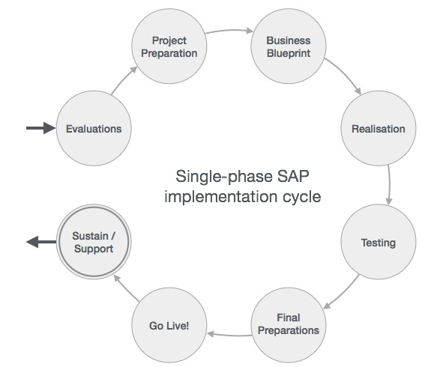
SAP Project Lifecycle

Slide 27
Q & A Thank you
Sudhan Paranjape
CTS ID 480916

